Slide 1

Rental Bike Management System
Group 7
Ajinkya Bhabad
Ankita Dharurkar
Colin Regan
Harshil Patel
Pranit Kolhe

Slide 2

What is Rental Bike System?
Rental bike system is designed to help customers to rent a bike for their trip.
The purpose of the database is to maintain data to determine the demand and supply of the rental bikes based on the weather data, the time period data, customer reviews and other recorded data.

Slide 3
Business Problems Addressed
• Understand the customer behavior to better serve them with their choice of bikes and thus the purpose of the ride whether exercise, daily commute or city tour.
• Make appropriate decisions on which bikes to buy and discontinue based on the demand.
• Gain insights on whether the customers prefer our bikes or the renters’ bike.
• To keep a track of the peak season/time thus helping the staff to manage operations.
• To track the costs of repairs and maintenance.
• Understand who our regular customers are (students, employees, tourists or others).
• To make decisions on membership rates depending on the number of members.
• To understand the operational costs and manage revenue.
• Understand segment of customers who regularly use rental bikes for common use, gain insights of the time of travel and create a special packages and memberships for those customers.

Slide 4
Schemas and Entities
Organization
Employees, Repairs, Bikes, Station
Clientele
Customers, Memberships, Booking Details, Promotions, Feedback
Supplier
Distributors, Renters, Bike Orders
Climate and Calendar
Weather, Time Period

Slide 5
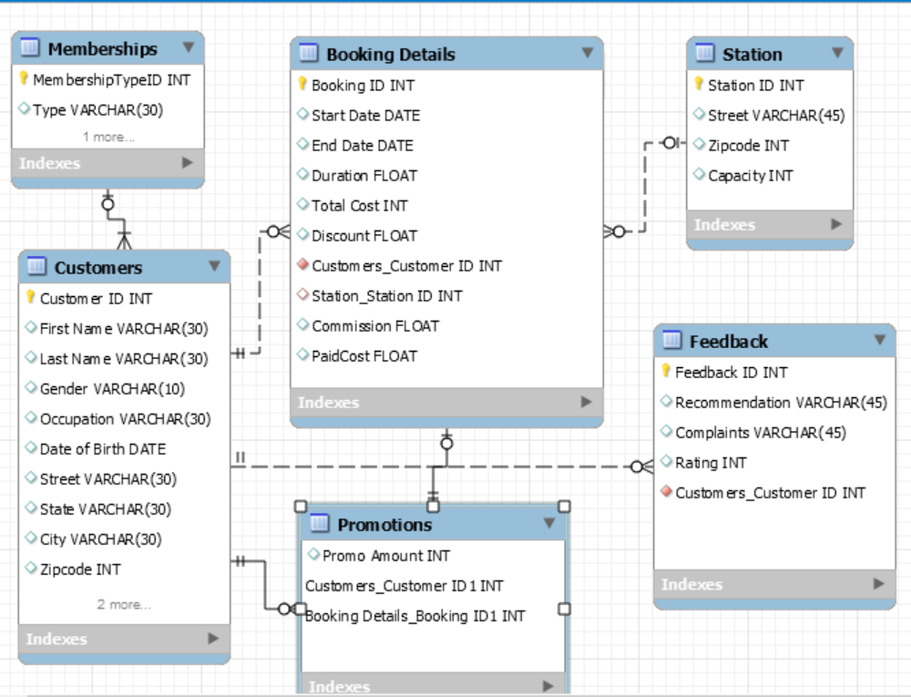
Booking Work-Flow

Slide 6
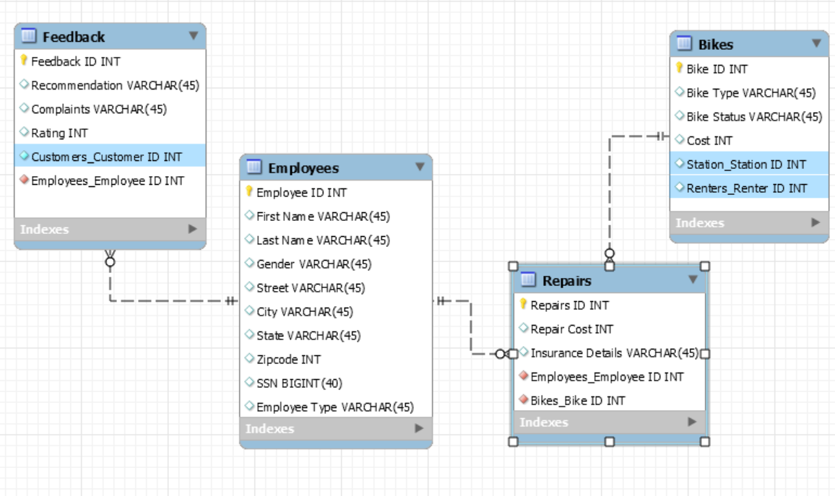
Bike Repair Flow

Slide 7
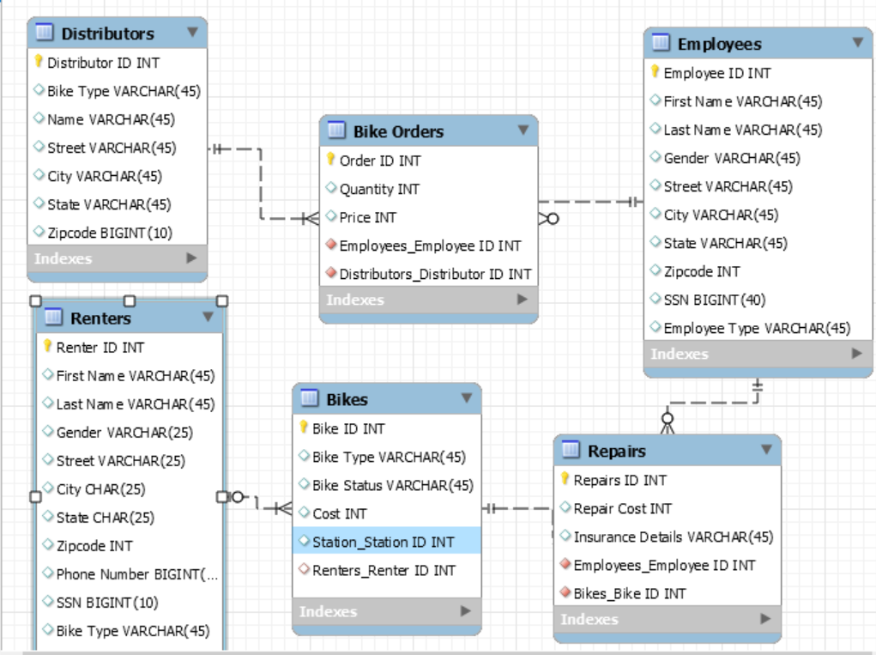
Ordering and Renting flow

Slide 8
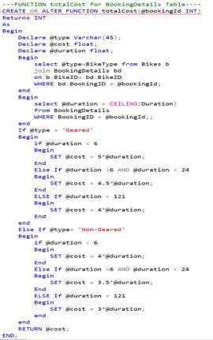
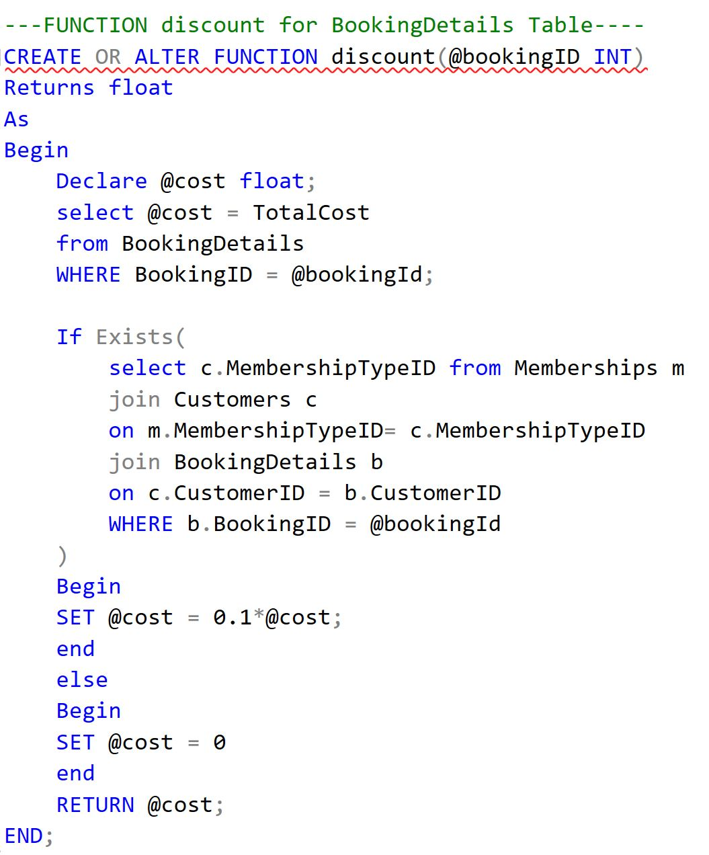
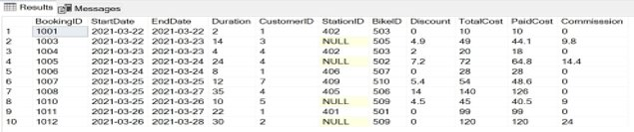
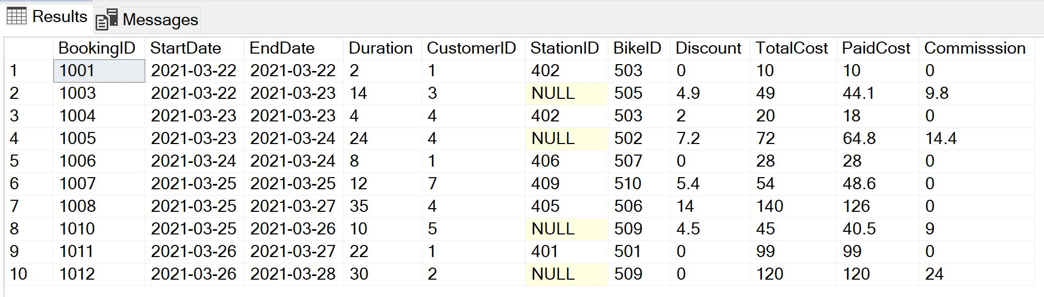
Function to compute Discount
Function to compute Total Cost

Slide 9
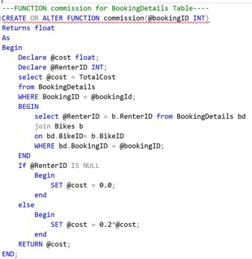
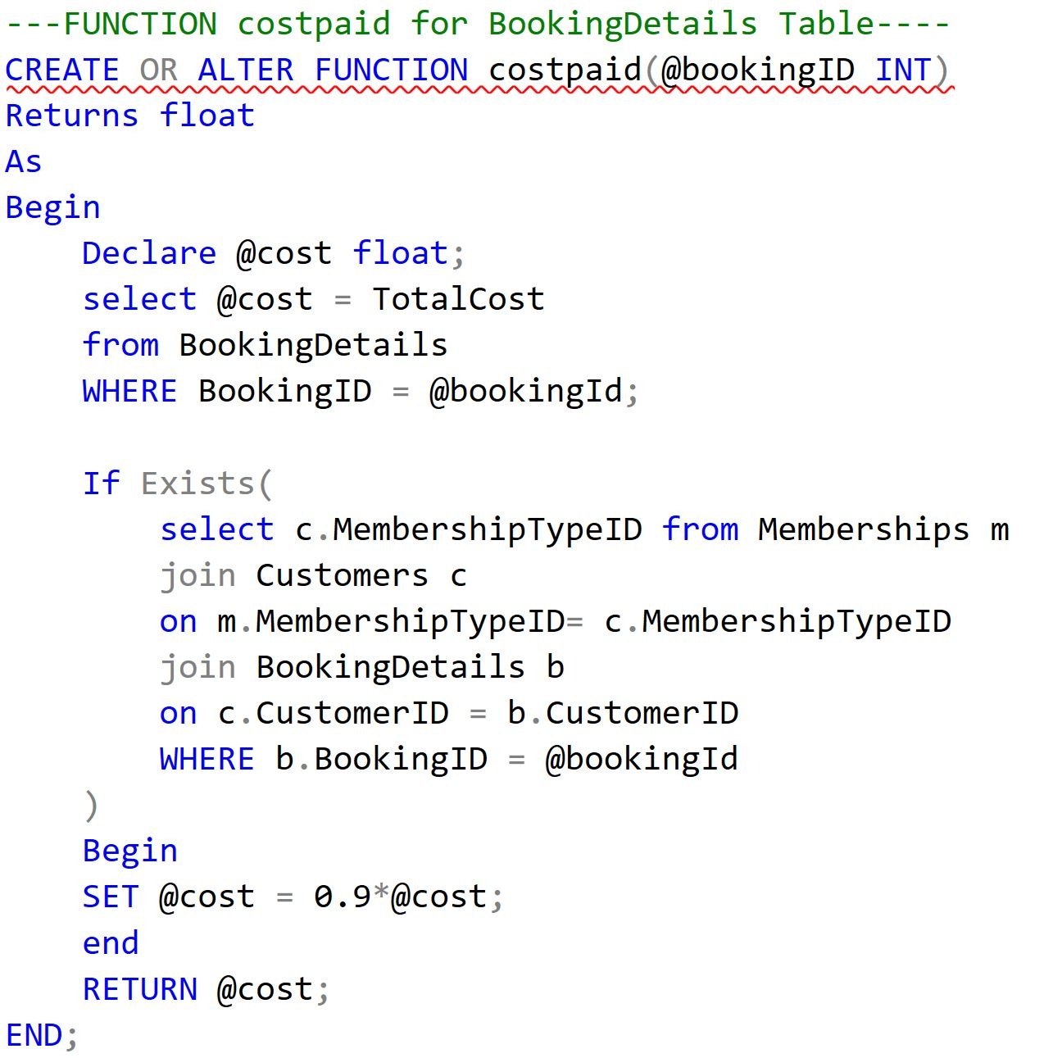
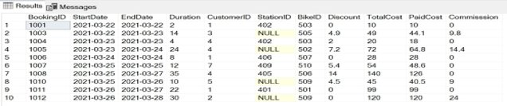
Function for computing Paid Cost
Function for computing Commission

Slide 10
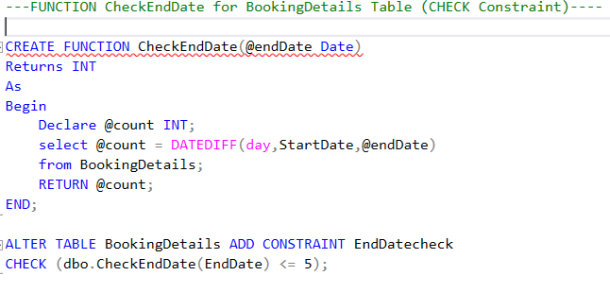
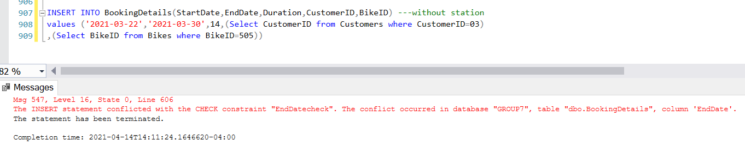
Checking the End Date

Slide 11
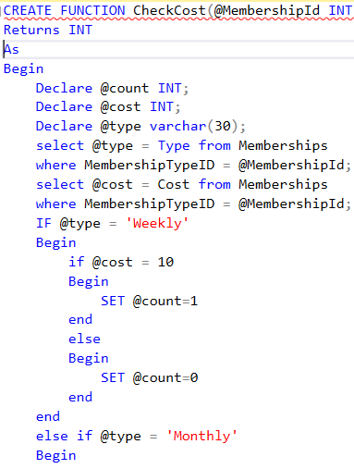
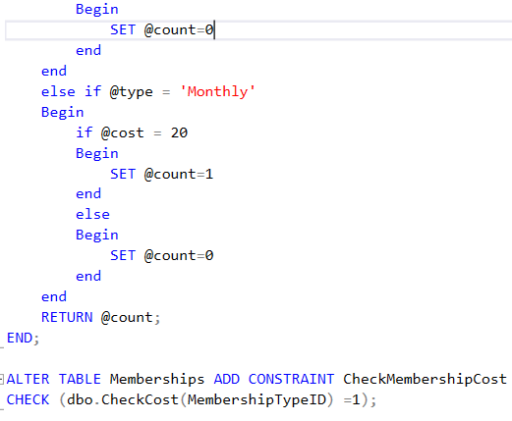
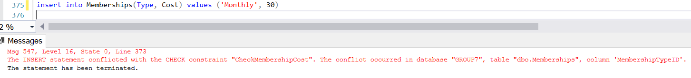
Checking the Membership Cost

Slide 12

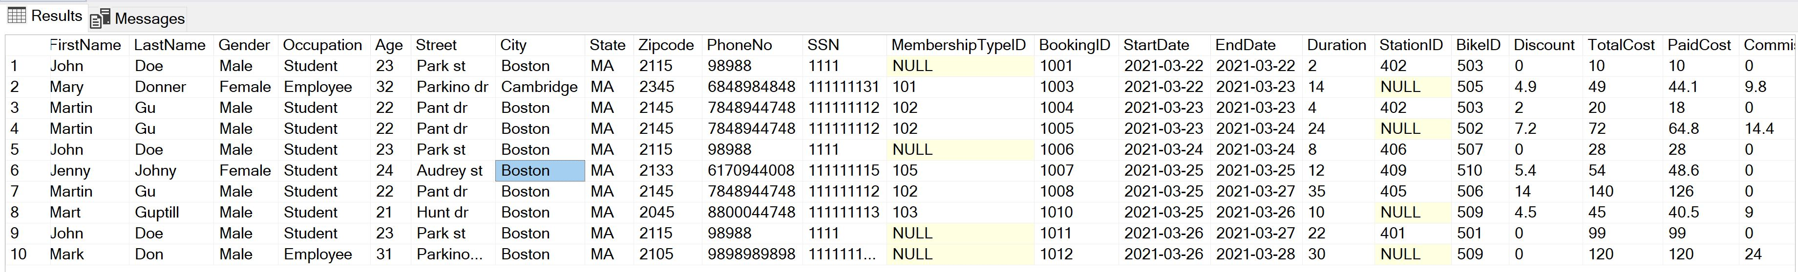
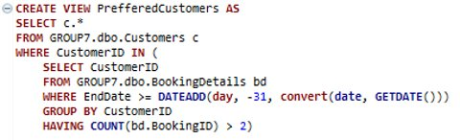
Views to see all Bike Rentals w/ Customer Info and Preferred Customers

Slide 13
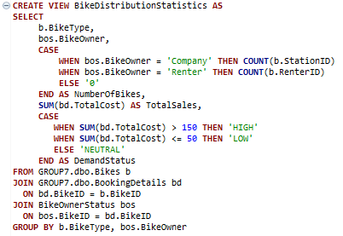
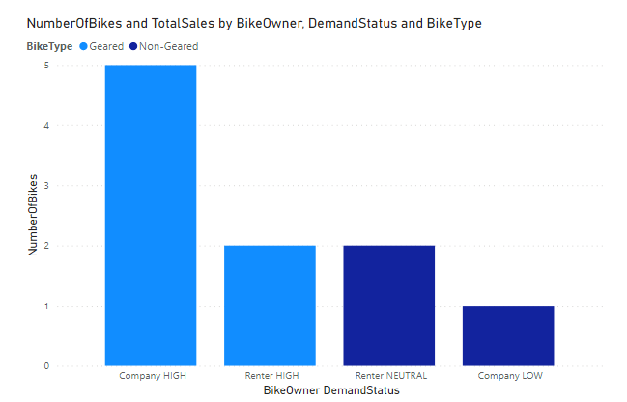
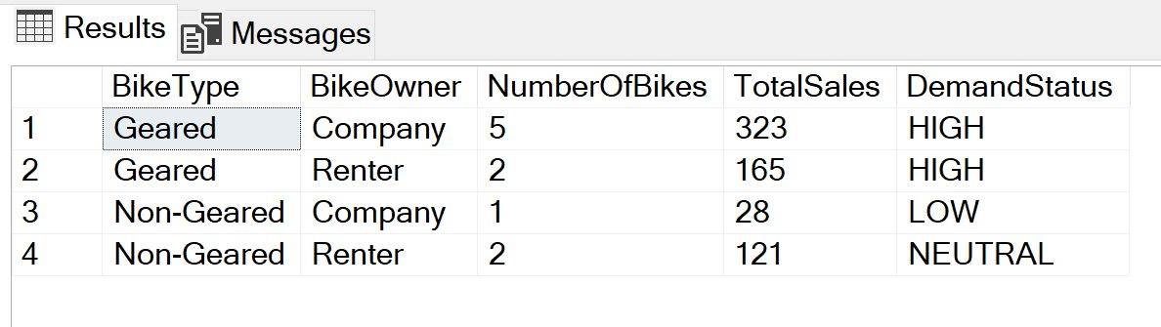
View to analyze Bike Demands

Slide 14
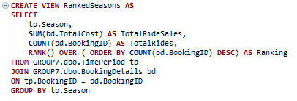
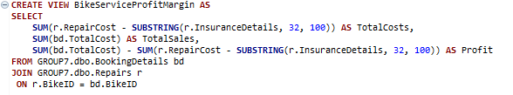
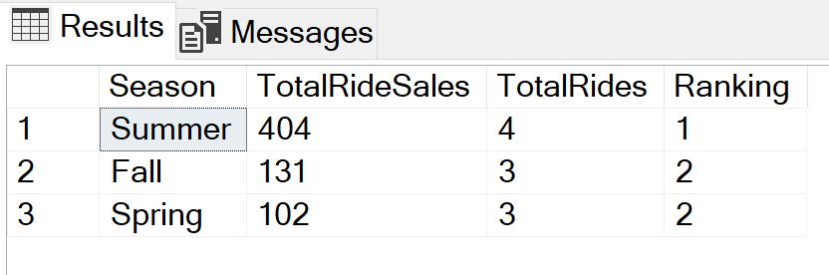
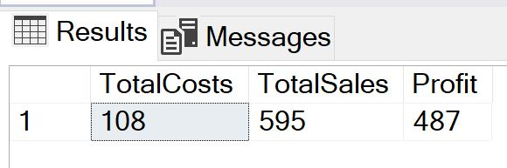
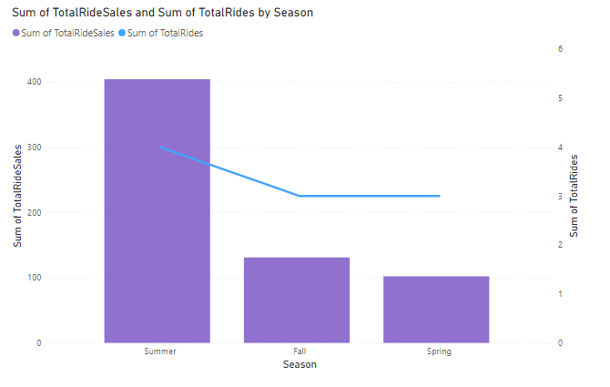
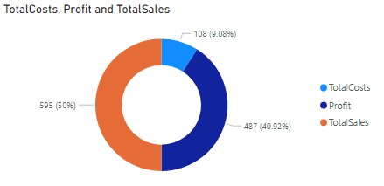
Views to analyze busy seasons and total Profits

Slide 15
Thank You.
Questions?

